Slide 1
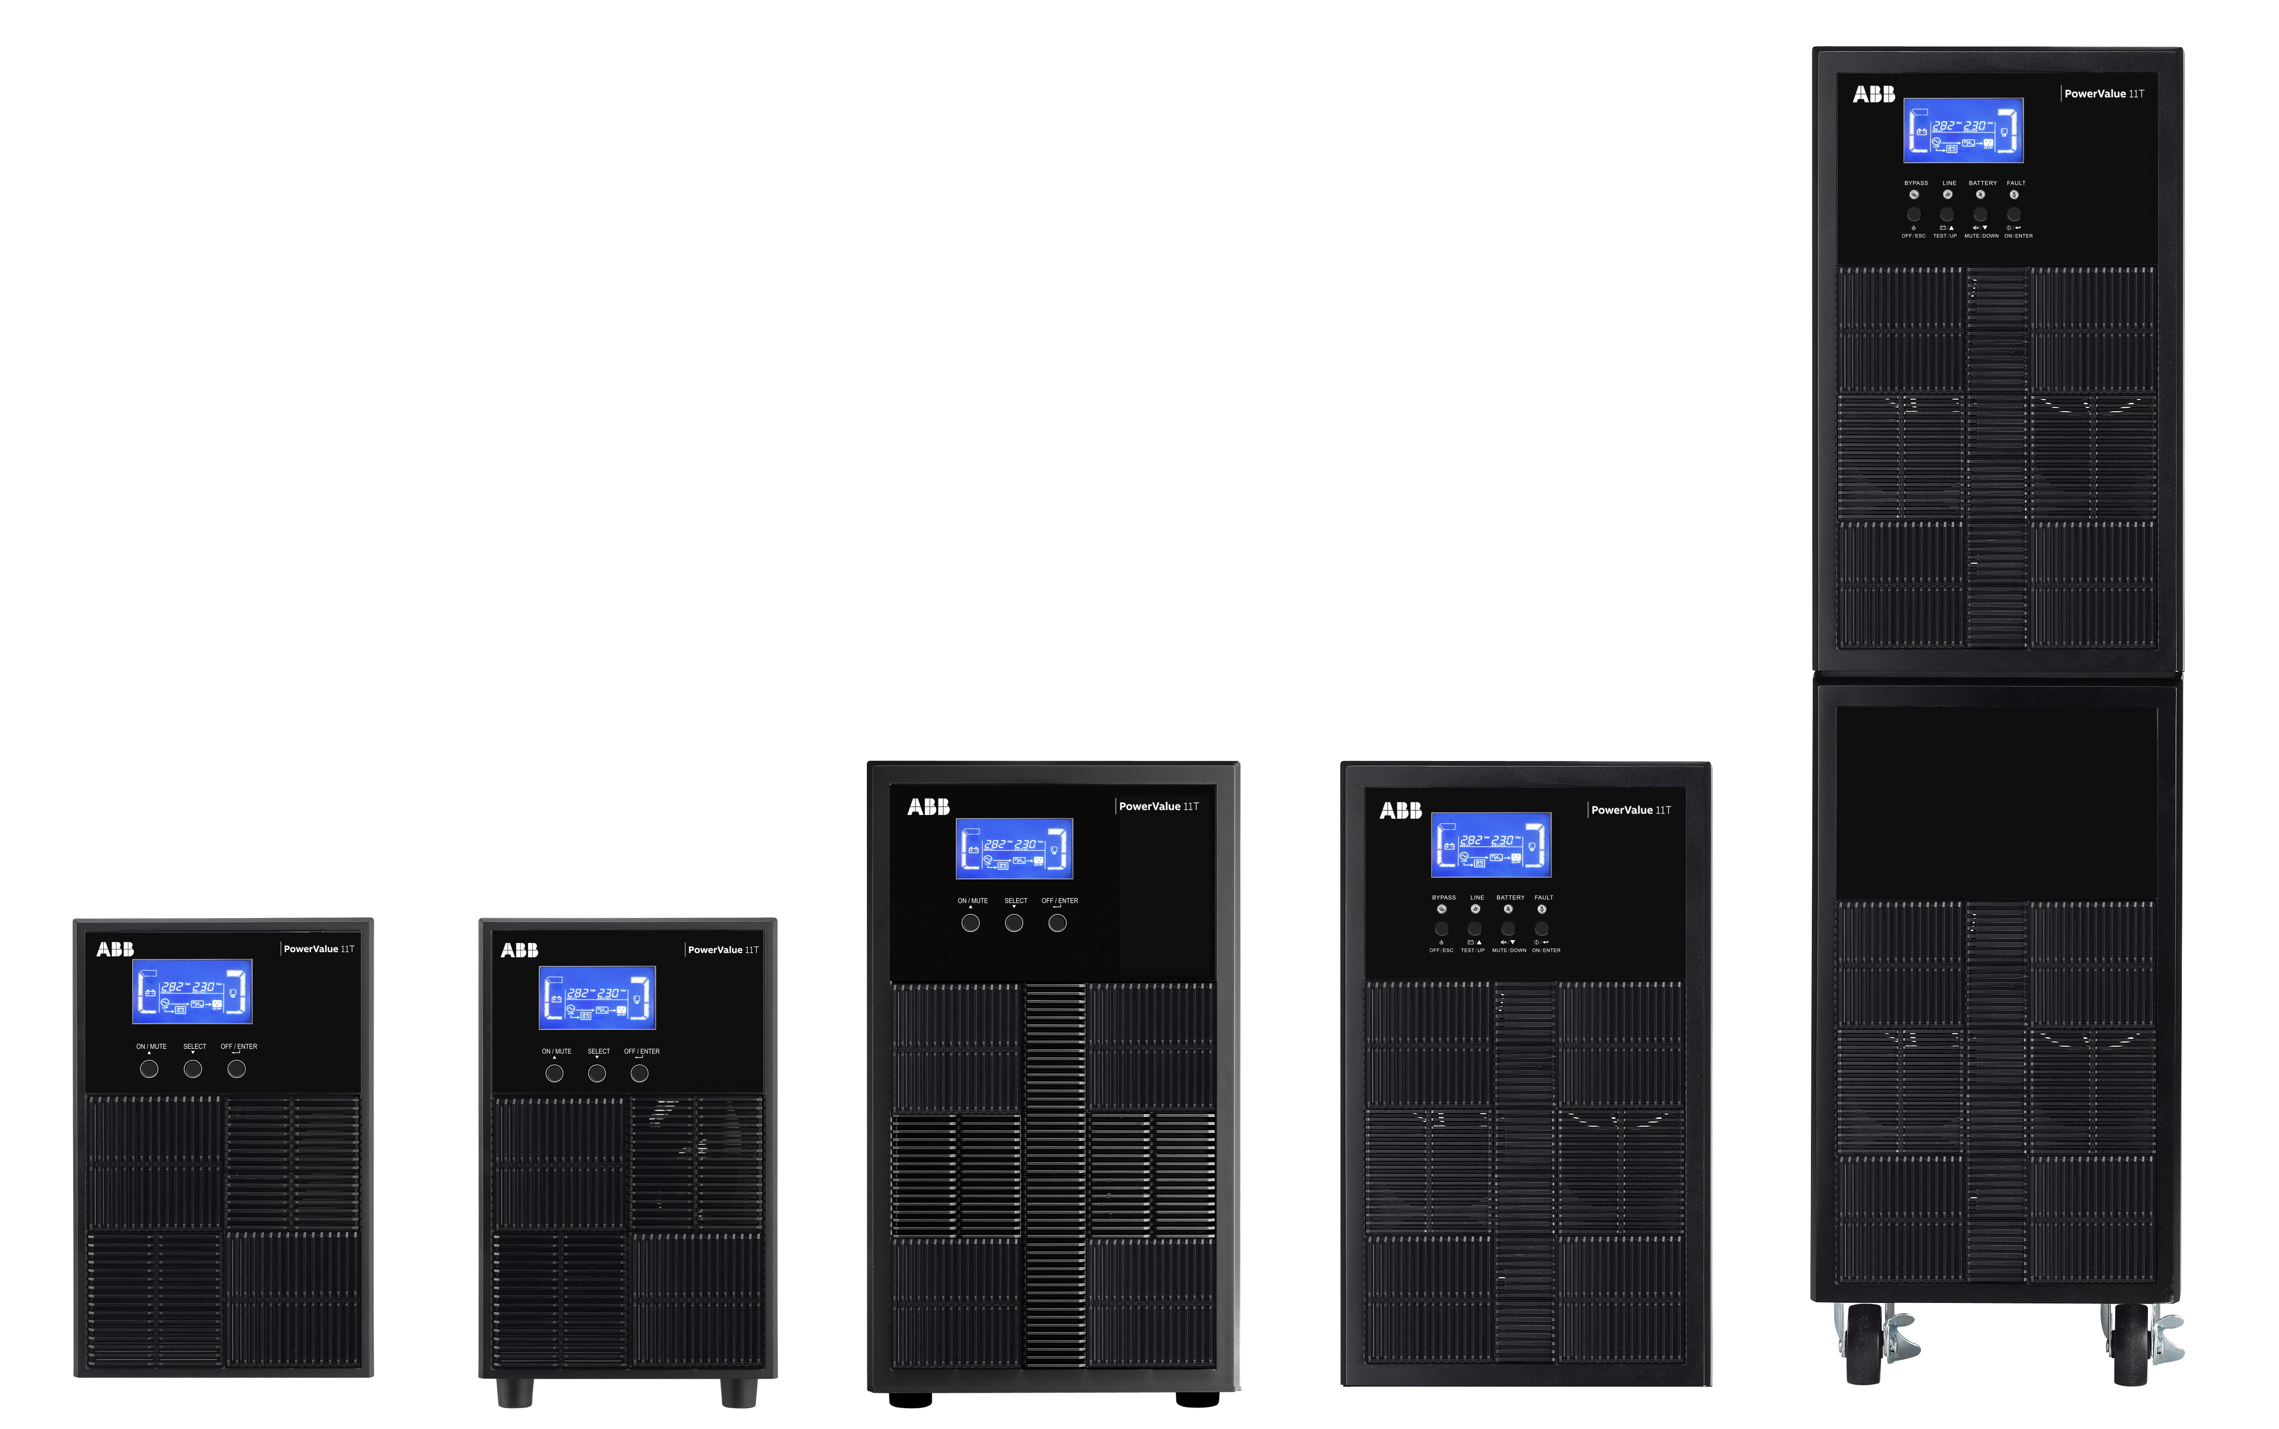
PowerValue 11T 1-10 kVA 1ph UPS
A cost effective solution for maximum power protection
Sachin K Aravind

Slide 2
Content
Applications
Feature highlights
Competitor landscape
Available models
Battery options
Runtime table (in mins, at 100% load)
Product view
Technical specifications
Connectivity

Slide 3



Applications
Tailored for small IT applications and dedicated loads
Examples:
ATM & vending machines
Small server rooms
Lab equipment
IT Equipment in Medical and Industrial
Transportation signaling systems
BMS room

Slide 4
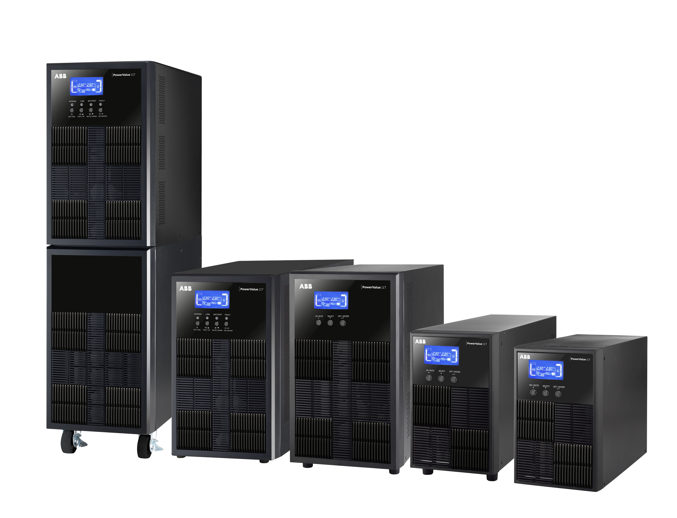
PowerValue 11T 1-10 kVA 1ph UPS
Feature highlights
Product features (*)
True on-line double conversion (VFI) tower UPS with OVCD – 1ph input / 1ph output
Minimizes energy losses with efficiency up to 90% 1 to 3 KVA & up to 93% - 6 and 10kva
Optimized for modern IT loads with rated output power factor up to 0.9
Most compact online UPS footprint available on the market → maximum power density
input PF ≥ 0.99 @ 100% linear load
Flexible configuration for scalable runtime: UPS with batteries (long backup)
Adjustable DC voltage and battery charger current
Digital charger technology provides accurate charger current setting and reduces charger ripple current
2 years base warranty for UPS and 1 year warranty for battery
  (*) Model dependent

Slide 5
PowerValue 11T 1-10 kVA 1ph UPS
Competitor landscape
Feature | ABB 11T 3kVA S | Schneider Smart UPS RC 3kva | Vertiv GXT MT+ 3KVA | Consul Finch 3KVA
Output pf | 0.9 ( all the range ) | 0.7 (all the range) | 0.9 ( All the range ) | 0.8 (all the range)
Family full power range | 900-9’000 W | 700 – 7000W | 900 – 9000 W | 800-8000 W
Dimensions (WxHxD) | 145x238x400 mm | 432x175x457 mm | 190 x 318 x 421 | 145x220x397 mm
Weight | 7.4 Kg | 34 Kg | 27.6kg | 7.4 Kg
Input voltage window | 180 – 270V | 160 – 280 V | 195 – 290 V | 160 – 280V
AC-AC efficiency | Up to 90% | Up to 90% | UP TO 90% | Up to 90%
Parallel | No | No | No | No
Over load | 110% - 5min, 130% - 15 sec, 150%- 1 sec @ 40 deg C | Not mentioned | 110% - 10 min, 130%-1min, @35deg C | 105%- 110%: 10mins; 110%- 130%- 1 min; >130%- 10 sec
Best in class performance in the smallest footprint

Slide 6
PowerValue 11T 1-10 kVA 1ph UPS
Available models
Model | Output power factor | Nominal rated power | Internal batteries / DC voltage |  | Dimensions WxHxD | Weight
1 kVA B | 0.9 | 1’000 VA / 900 W | 2 x 12v 9Ah |  | 145x223x288 mm | 9.3 Kg
1 kVA S | 0.9 | 1’000 VA / 900 W | 36 vdc / 4 Amps |  | 145x223x288 mm | 4.2 Kg
2 kVA B | 0.9 | 2’000 VA / 1’800 W | 4 x 12v 9Ah |  | 145x238x400 mm | 16.8Kg
2 kVA S | 0.9 | 2’000 VA / 1’800 W | 72 vdc / 4 Amps |  | 145x238x400 mm | 6.8 Kg
3 kVA B | 0.9 | 3’000 VA / 2’700 W | 6 x 12v 9Ah |  | 190x336x425 mm | 26.8 Kg
3 kVA S | 0.9 | 3’000 VA / 2’700 W | 72 vdc / 4 Amps |  | 145x238x400 mm | 7.4 Kg
6 kVA B | 0.9 | 6’000 VA / 6’000 W | 16 x 12v 9Ah |  | 190x686x369 mm | 61 Kg
6 kVA S | 0.9 | 6’000 VA / 6’000 W | 192 vdc / 6 Amps |  | 190x318x369 mm | 12 Kg
10 kVA B | 0.9 | 10’000 VA / 10’000 W | 20 x 12v 9Ah |  | 190x686x442 mm | 76 Kg
10 kVA S | 0.9 | 10’000 VA / 10’000 W | 240 vdc / 4 Amps |  | 190x318x442 mm | 16 Kg

Slide 7
PowerValue 11T 1-10 kVA 1ph UPS
Battery options
  External Battery Modules (EBM) are available to increase the system runtime
  Each EBM is dedicated to its correspondant UPS
  It’s recommended to connect up to 4 EBM per UPS for UPS with internal batteries or up to 20 EBMs / max 300 Ah for S models (6-10 kVA)
  Empty EBM cases are available, too, with links and trays for a personalized battery capacity
  Easy setup via the LCD display menu
Model | Nominal rated power | Internal batteries | Battery charger / Back up time @ 75% Load | EBM
1 kVA B | 1’000 VA / 900 W | 2 x 12v 9Ah | 24V DC / 1.5 A / 5min | 3 x 12v 9Ah x 2
1 kVA S | 1’000 VA / 900 W | No | 36v dc / 4A (adjustable*)
2 kVA B | 2’000 VA / 1’800 W | 4 x 12v 9Ah | 48V DC / 1.5 A / 6min | 4 x 12v 9 Ah x 3
2 kVA S | 2’000 VA / 1’800 W | No | 72 vdc / 4A (adjustable*)
3 kVA B | 3’000 VA / 2’700 W | 6 x 12v 9Ah | 72V DC / 1.5 A / 6 min | 6 x 12v 9Ah x 2
3 kVA S | 3’000 VA / 2’700 W | No | 72 vdc -4A (adjustable*)
6 kVA B | 6’000 VA / 5’400 W | 16 x 12v 9Ah | 192V DC / 2A / 16 min | 16 x 12v 9Ah
6 kVA S | 6’000 VA / 5’400 W | No | 192 vdc / 6 Amps
10 kVA B | 10’000 VA / 9’000 W | 20 x 12v 9Ah | 240v DC / 2A / 7 min | 20 x 12v 9 Ah
10 kVA S | 10’000 VA / 9’000 W | No | 240 vdc / 4 Amps

Slide 8
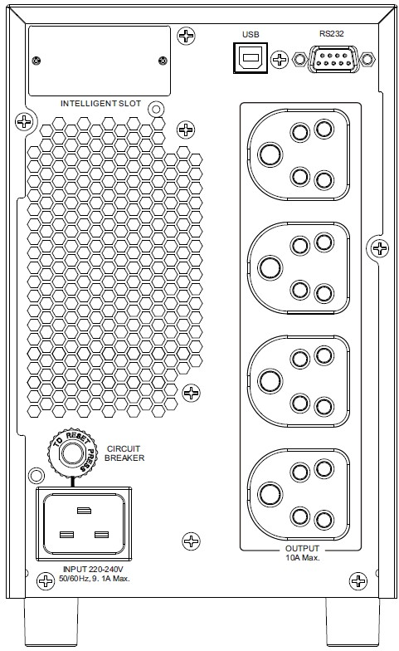
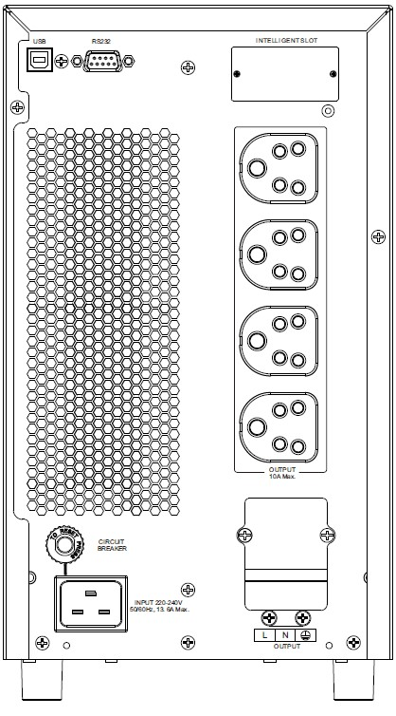
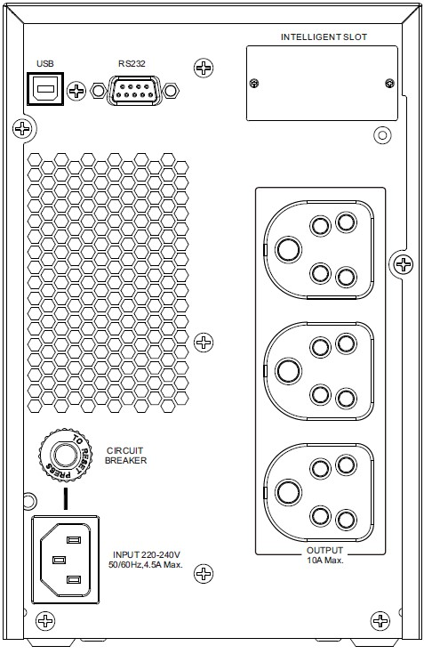
PowerValue 11T 1-10 kVA 1ph UPS
Product view (1-3 kVA B)
4
2
3
2
3
4
1 | AC input 10 A
2 | USB port
3 | RS-232
4 | Mini SNMP/ModBus/AS400
5 | EPO / dry input
6 | AC output 10 A
7 | AC input 16 A
8 | Output breaker
9 | AC output 16 A
10 | EBM connector
3
4
10
6
2
8
8
8
1
7
7
6
6
1 kVA B
2 kVA B
3 kVA B

Slide 9
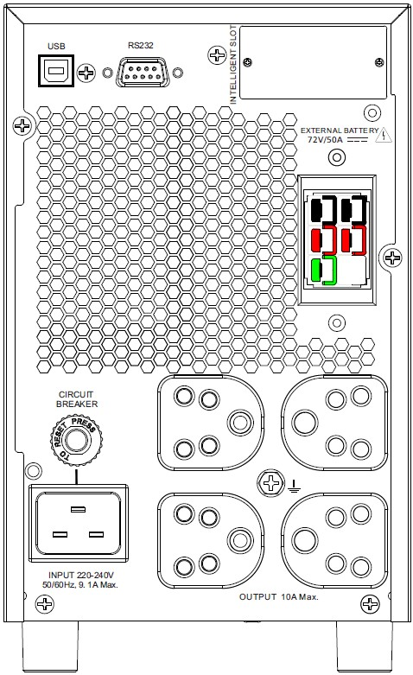
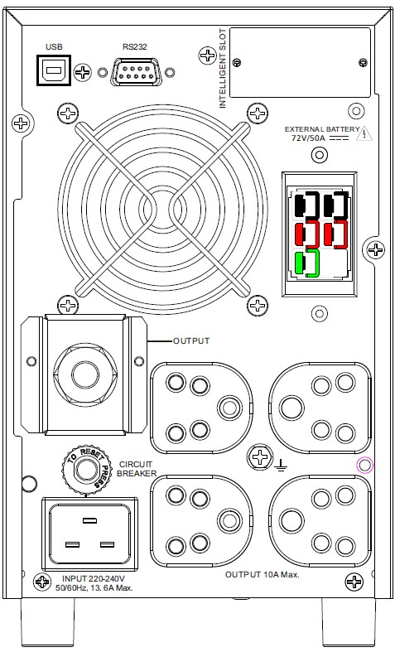
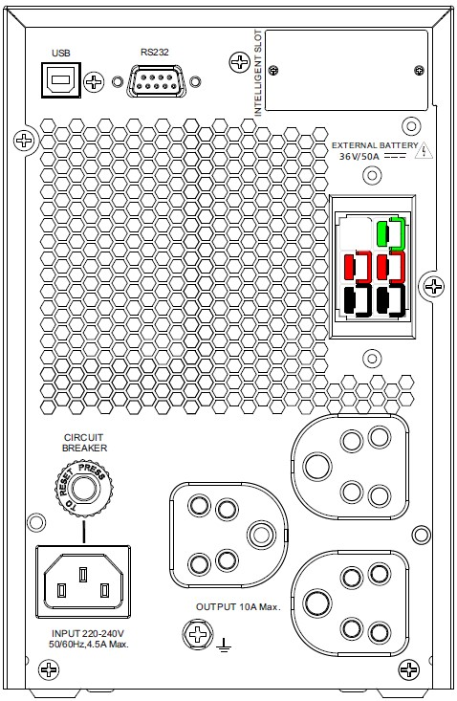
PowerValue 11T 1-10 kVA 1ph UPS
Product view (1-3 kVA S)
1 | AC input 10 A
2 | USB port
3 | RS-232
4 | Mini SNMP/ModBus/AS400
5 | EPO / dry input
6 | AC output 10 A
7 | AC input 16 A
8 | AC output 20 A
9 | EBM connector
10 | Output breaker
11 | GND contact
2
3
4
2
3
4
2
3
4
9
9
9
10
6
6
10
11
10
11
7
9
7
10
1
11
6
1 kVA S
2 kVA S
3 kVA S
11

Slide 10
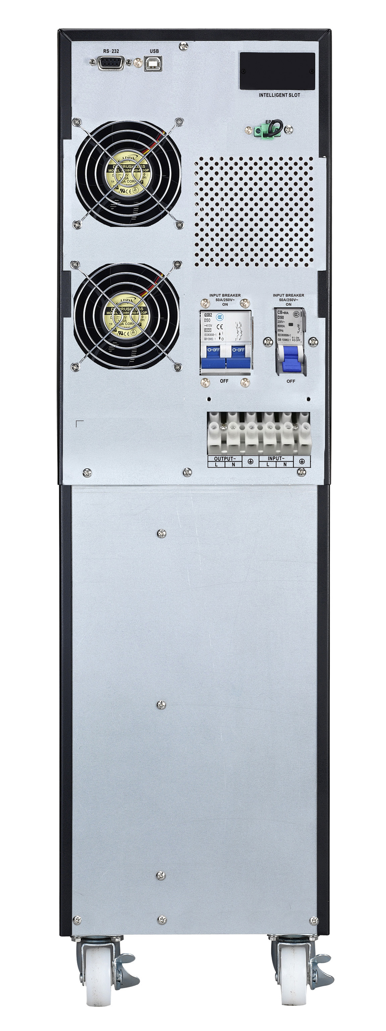
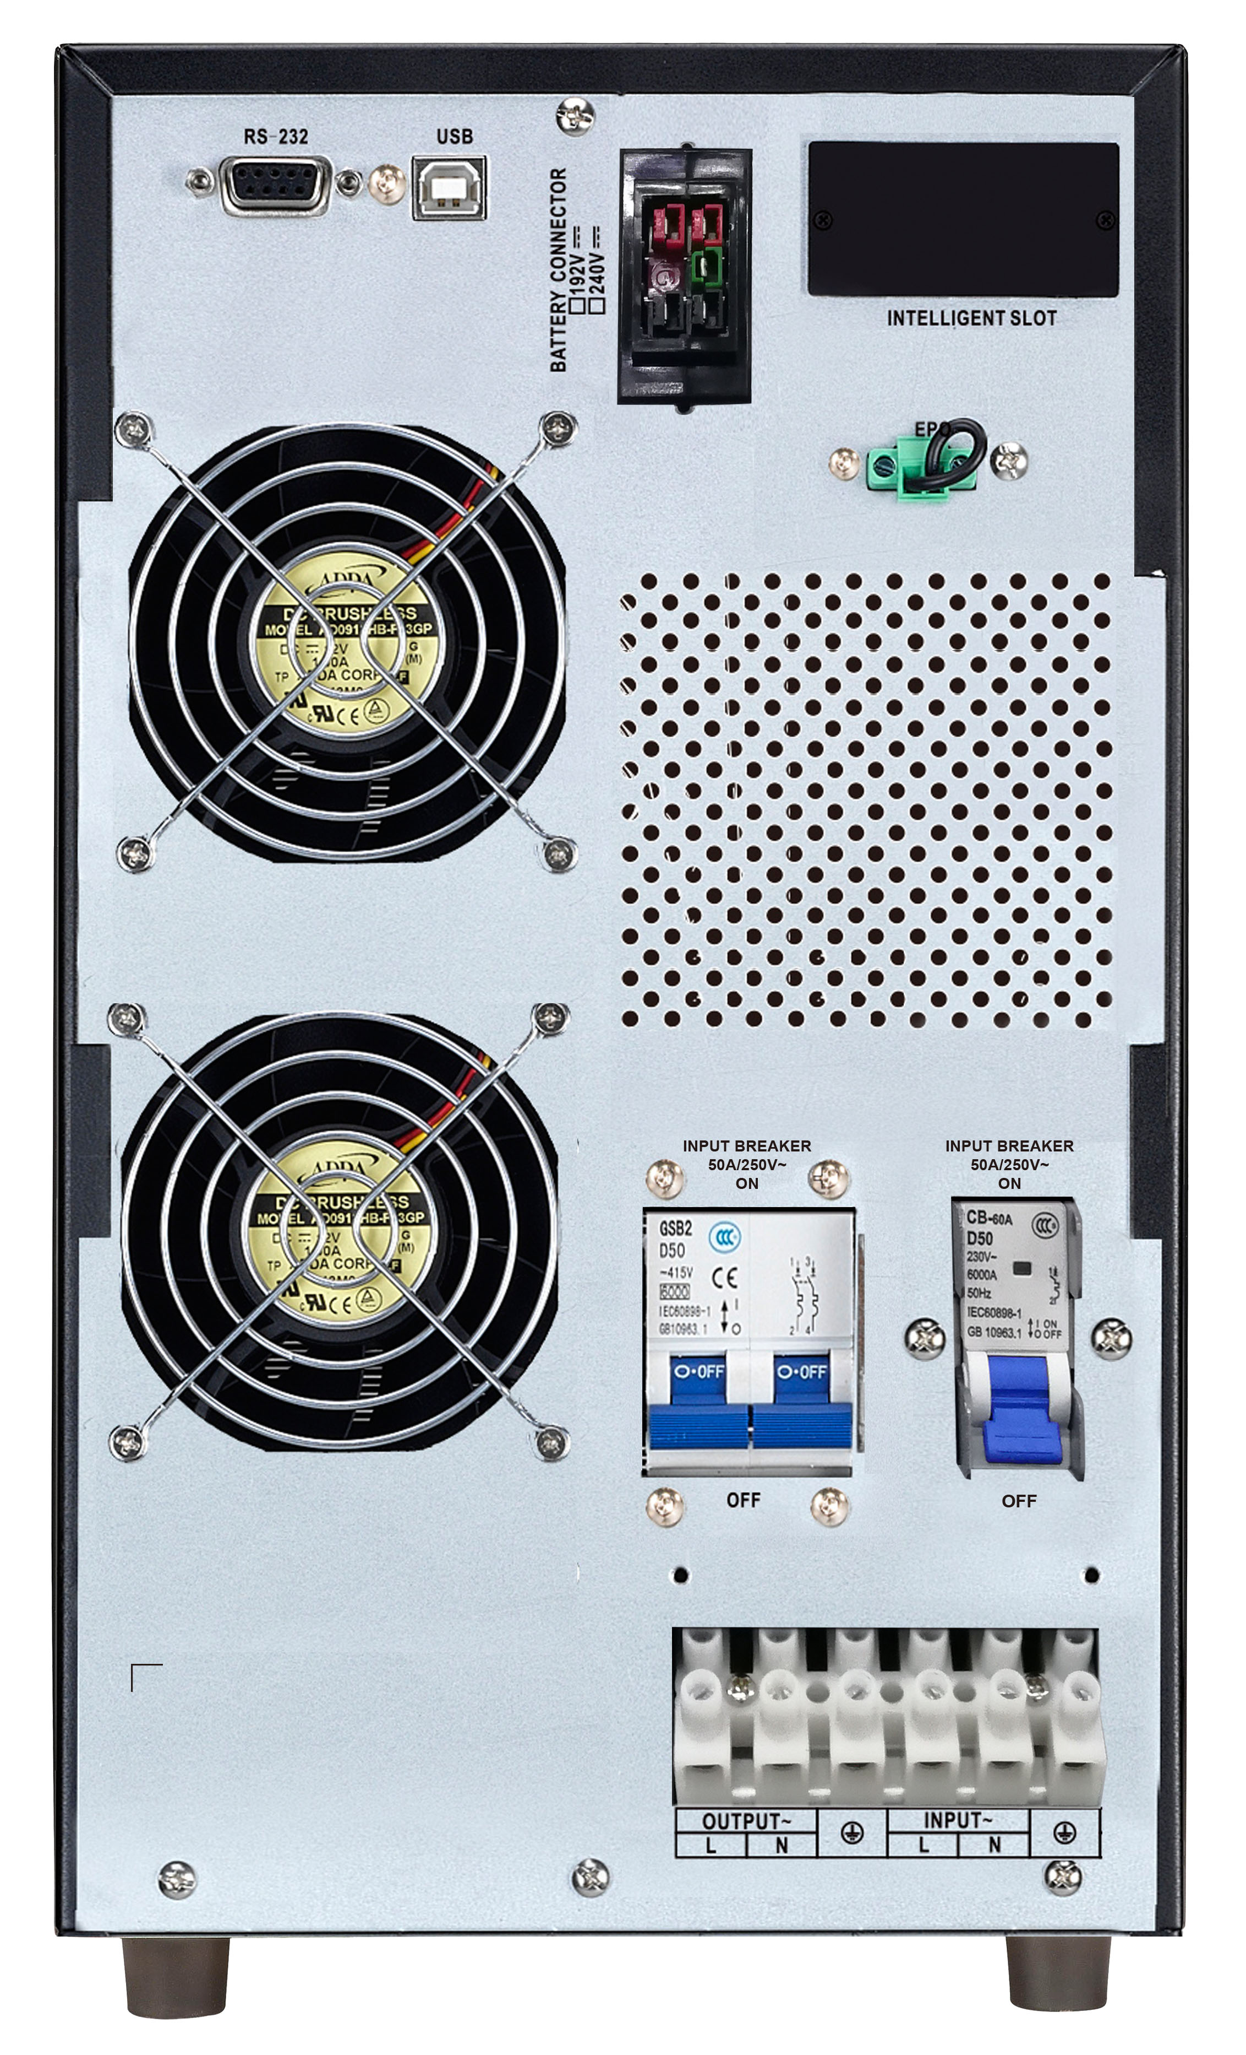
PowerValue 11T 1-10 kVA 1ph UPS
Product view (6-10 kVA)
3
2
1
1 | SNMP/ModBus/AS400
2 | USB port
3 | RS-232
4 | Reserved for future use
5 | EBM connector
6 | Dry in / out
7 | Parallel port
8 | EPO
9 | MBP switch
10 | Input breaker
11 | I/O terminals
8
3
2
5
1
10
6
11
8
10
6
11
6 kVA S/
10 kVA S
10
6 kVA B
10 kVA B

Slide 11
PowerValue 11T 1-10 kVA 1ph UPS
Technical specifications (1-3 kVA)
UPS | 1kVA B / S | 2kVA B / S | 3kVA B / S
Rated power | 900 W | 1’800W | 2’700W
Output power factor | 0.9 | 0.9 | 0.9
Parallelable | No | No | No
Internal batteries | 2 x 12v 9ah | 4 x 12v 9Ah | 6 x 12v 9Ah
Nominal input voltage | 220-230-240 Vac | 220-230-240 Vac | 220-230-240 Vac
Input voltage tolerance | 135-300 Vac | 135-300 Vac | 135-300 Vac
THDi | <12% (linear load) | <12 % (linear load) | <12% (linear load)
Input frequency range | 46-55 Hz | 45-55 Hz | 45-55 Hz
Input power factor | ≥0.99 | ≥0.99 | ≥0.99
Rated output voltage | 220-230-240 Vac | 220-230-240 Vac | 220-230-240 Vac
Output voltage tolerance | ± 1 % | ± 1 % | ± 1 %
THDv | <3% (linear lode), <6% (non linear load) | <3% (linear lode), <6% (non linear load) | <3% (linear lode), <6% (non linear load)
Overload capability | 130%-150% load : 3 sec 110% - 130% load : 10 sec 105% - 110% load : 10 min | 130%-150% load : 3 sec 110% - 130% load : 10 sec 105% - 110% load : 10 min | 130%-150% load : 3 sec 110% - 130% load : 10 sec 105% - 110% load : 10 min
Output nominal frequency | 50/60 Hz | 50/60 Hz | 50/60 Hz
Charging current | B: 1A ( +/-10%) S: 4A (adjustable) | B: 1A ( +/-10% ) S: 4A ( adjustable ) | B:1 A (+/-10%) S: 4A ( adjustable )
Efficiency | Up to 88% | Up to 88% | Up to 90%
Operative temperature | 0° - 40° C | 0° - 40° C | 0° - 40° C
Net weight | B: 9.3 Kg S: 4.2 Kg | B: 16.8 Kg S: 6.8 Kg | B: 26.8 Kg S: 7.4 Kg
Net dimensions W × H × D | B: 145 x 223 x 288 mm S: 145 x 223 x 288 mm | B: 145 x 238 x 400 mm S: 145 x 238 x 400 mm | B: 190 x 336 x 425 mm S: 145 x 238 x 400 mm

Slide 12
PowerValue 11T 1-10 kVA 1ph UPS
Technical specifications (6-10 kVA)
UPS | 6kVA B / S | 10kVA B / S
Rated power | 6’000 kva | 10’000 kva
Output power factor | 0.9 | 0.9
Parallelable | no | no
Internal batteries | 16 x 12v 9Ah | 20 x 12v 9 Ah
Nominal input voltage | 208-220-230-240 Vac | 208-220-230-240 Vac
Input voltage tolerance | 110-300 Vac | 110-300 Vac
THDi | < 5 % ( 100% Linear Load ) | < 5% ( 100% Linear Load )
Input frequency range | 46-54Hz | 46-54Hz
Input power factor | ≥0.99 @100% | ≥0.99 @100%
Rated output voltage | 208-220-230-240 Vac | 208-220-230-240 Vac
Output voltage tolerance | ± 1 % | ± 1 %
THDv | <3% (linear lode), <5% (non linear load) | <3% (linear lode), <5% (non linear load)
Overload capability on inverter | > 130% load : 10 sec 130% load : 5 min 110% load : 30 min | > 130% load : 10 sec 130% load : 5 min 110% load : 30 min
Output nominal frequency | 50-60 Hz | 50-60 Hz
Charging current | B 1A S: 1A, 2A, 4A, 6A (adjustable) for 16pcs battery | B 2A S: 1A, 2A, 4A(adjustable) for 20pcs battery
Efficiency | Up to 92% | Up to 93%
Operative temperature | 0° - 40° C | 0° - 40° C
Net weight | B 61 Kg / S 12 Kg | B 76 kg / S 16 Kg
Net dimensions W × H × D | B : 190 x 688 x 369 mm S : 190 x 318 x 369 mm | B : 190 x 688 x 442 mm S: 190 x 318 x 442 mm

Slide 13
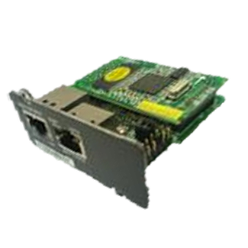
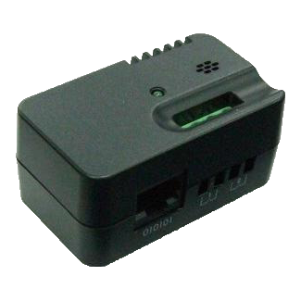
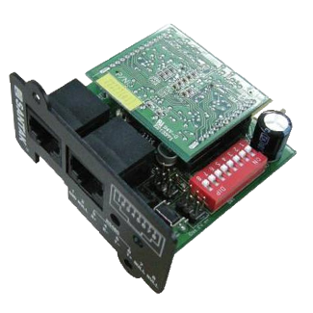
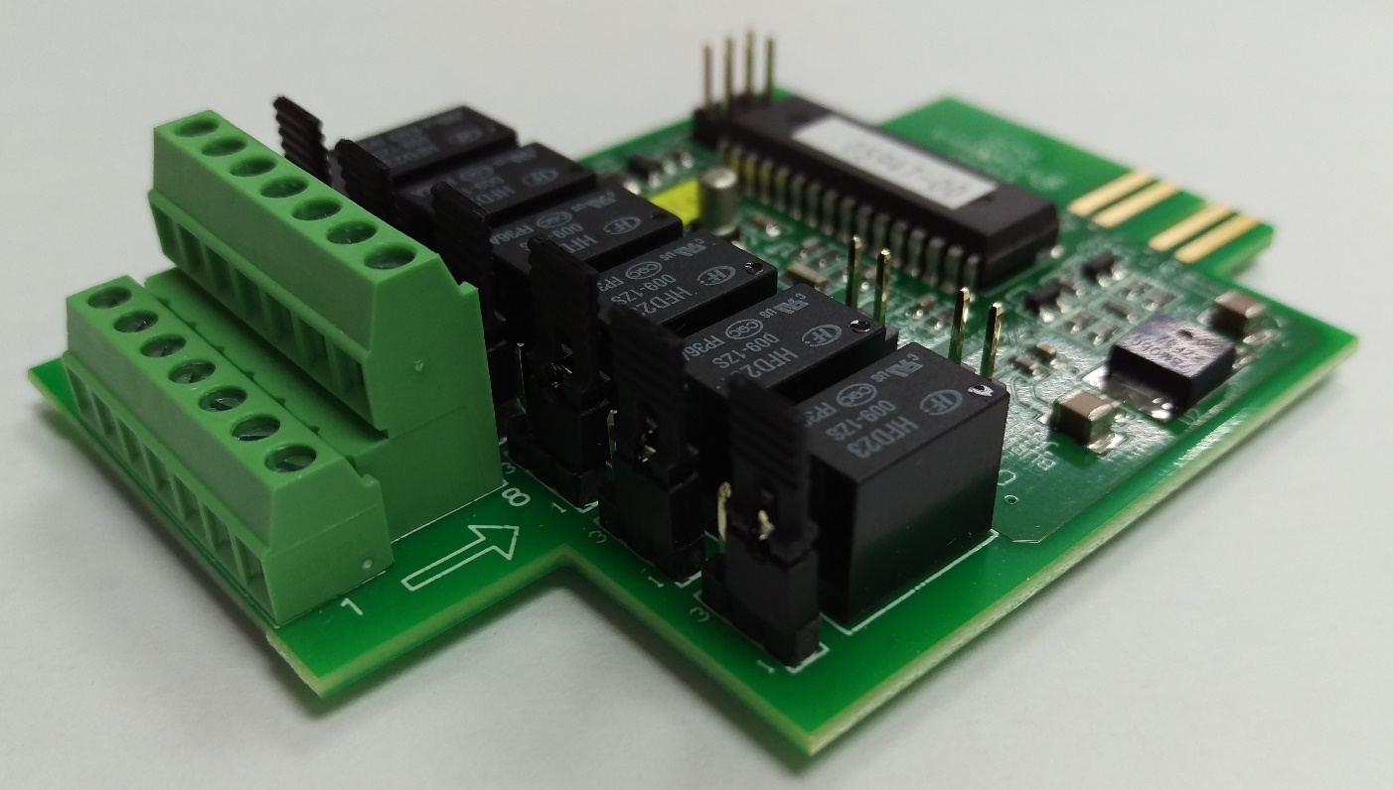
PowerValue 11T 1-10 kVA 1ph UPS
Connectivity for 1-3 kVA
 | Winpower Mini SNMP slot card , basic connectivity option, supports SNMP and remote shutdown (ModBus not supported)
 | EMP for Winpower Mini SNMP, environmental monitoring probe with temperature and humidity sensors
 | Winpower Mini ModBus slot card, enables ModBus over RS485 only (SNMP and ModBus over TCP/IP not supported)
 | Mini AS400 slot card, with potential free I/O contacts

Slide 14
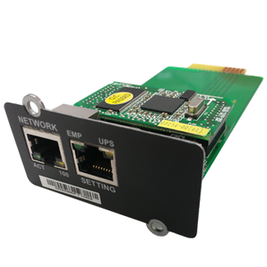
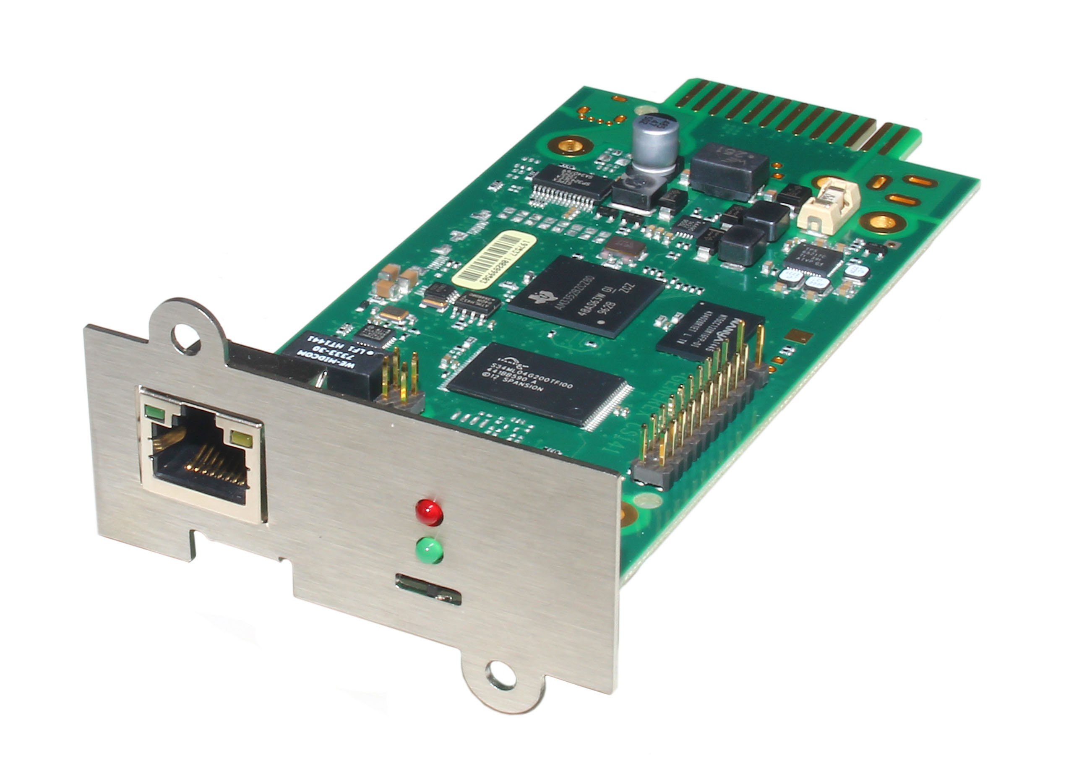
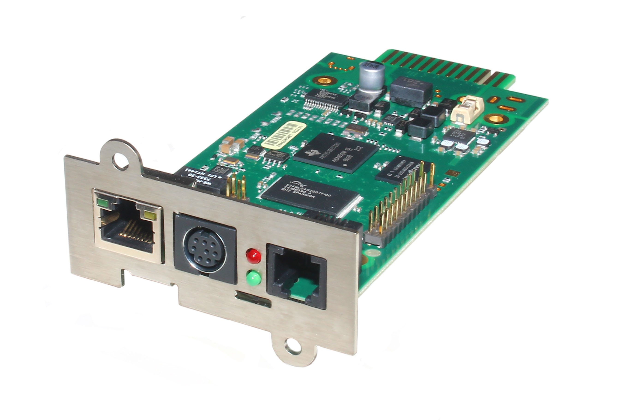
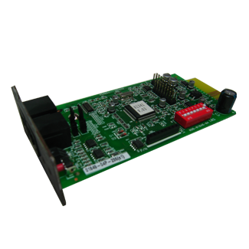
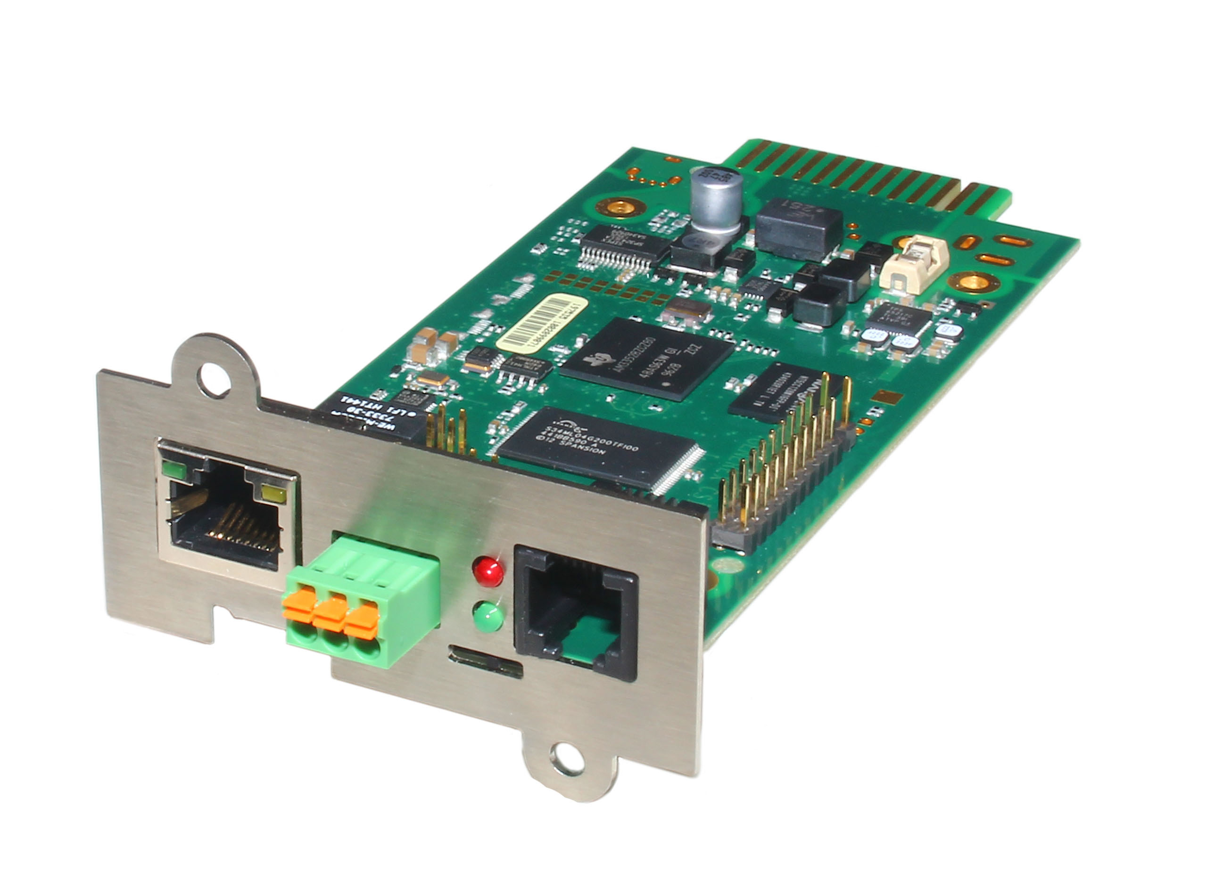
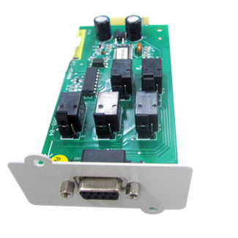
PowerValue 11T 1-10 kVA 1ph UPS
Connectivity for 6-10 kVA
 | Winpower SNMP slot card , basic connectivity option, supports SNMP and remote shutdown (ModBus not supported)
 | EMP for Winpower SNMP, environmental monitoring probe with temperature and humidity sensors
 | Winpower ModBus slot card, enables ModBus over RS485 only (SNMP and ModBus TCP/IP not supported)
 | AS400 slot card, with potential free I/O contacts
 | CS141 Basic (box/slot) SNMP / ModBus over TCP/IP
 | CS141 Advanced (box/slot) SNMP/ModBus over TCP/IP, sensor interface
 | CS141 ModBus (box/slot) SNMP/ModBus over TCP/IP and over RS485

